Slide 1

ARC FACE: ADDITIVE ANGULAR MARGIN LOSS FOR DEEP FACE RECOGNITION
PRESENTED BY:
SHRUTHI BOBBA
VARSHA REDDY CHINTHALAPUDI

Slide 2
Dataset Information
Dataset Size: 200 samples
Individuals: 10 people
Images per Individual: 20
Data Split:
Training/Validation: 90% of the dataset
Test: 10% of the dataset
Stratified Split for Training/Validation:
Training: 88% of the Training/Validation set
Validation: 12% of the Training/Validation set

Slide 3

DATA PROCESSING
Facial Annotation: Employed MTCNN for precise facial annotation.
Labeling: Assigned labels to each image, saved in a CSV file.
Image Cropping: Processed images by cropping based on facial regions.
Transformations: Applied transformations including resizing (112x112), converting to tensor, and pixel value normalization.

Slide 4
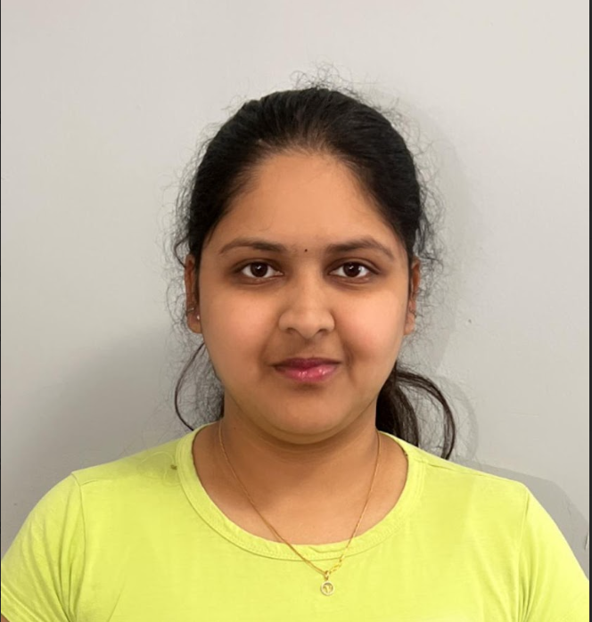


Raw
Annotated
Processed

Slide 5
MobileFaceNet Model
Our facial recognition system is powered by the MobileFaceNet network, a compact yet powerful architecture designed for efficient face recognition. The network consists of several key components:
Initial Convolutional Layers: MobileFaceNet begins with convolutional layers for basic feature extraction, ensuring a strong foundation for subsequent stages.
Depth-wise Convolutional Blocks: These blocks leverage depth-wise convolutions, enhancing computational efficiency. They capture intricate patterns in facial features while minimizing computational load.
Residual Blocks: The network incorporates residual blocks, a hallmark of effectiveness in deep learning. These blocks facilitate the learning of complex facial representations.
Linear and Batch Normalization Layers: MobileFaceNet utilizes linear layers for dimensionality reduction and batch normalization layers for improved training stability.
Embedding Layer: The final layer produces an embedding of facial features, enabling accurate face recognition.
MobileFaceNet's streamlined architecture makes it well-suited for real-time applications, providing a robust solution for facial identification.

Slide 6
MobileFaceNet Model:
Key Characteristics
Lightweight Architecture
Efficient Facial Feature Extraction
Suitable for Real-time Applications

Slide 7
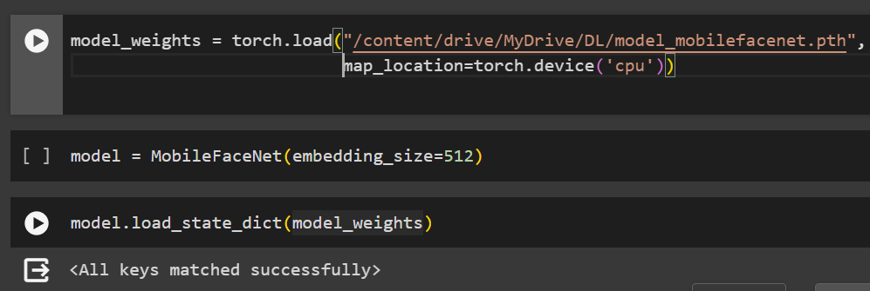
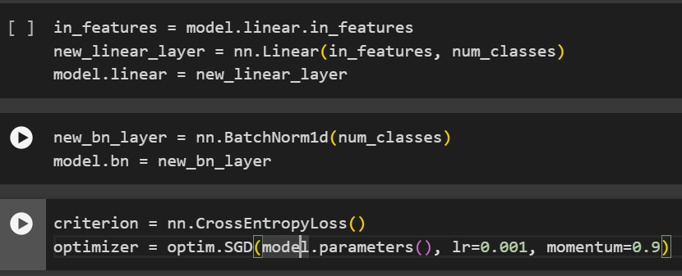
Model Loading and Customization
Load Pre-trained Weights:
Customize Output Layer:

Slide 8

Objective Function: Cross-Entropy Loss
Utilized for training the model in classification tasks.
Measures the disparity between predicted and actual class probabilities.
Effective in guiding the model to improve accuracy.

Slide 9
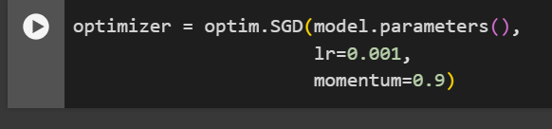
Optimization: Stochastic Gradient Descent (SGD)
Optimization algorithm used to adjust model parameters.
Iteratively minimizes the Cross-Entropy Loss during training.
Parameters include learning rate (lr) and momentum for efficient convergence.

Slide 10
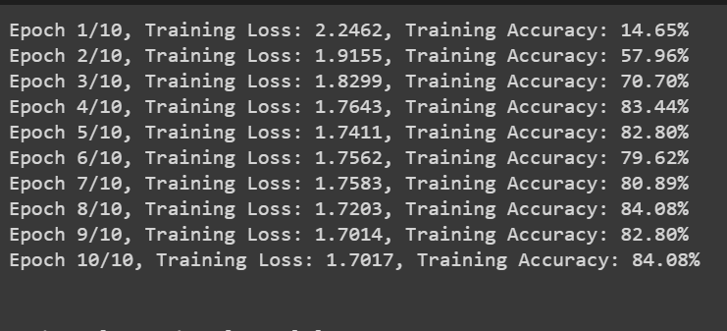
Training Performance

Slide 11
Hyperparameter Tuning
Learning Rates: Explored a range of values (1e-5, 1e-4, 1e-3, 1e-2).
Momentums: Investigated different momentum values (0.9, 0.95, 0.99).
Training Process:
Iterated through combinations using Stochastic Gradient Descent (SGD).
Trained the model for 10 epochs per combination.
Monitored and recorded validation loss for each combination.
Updated the best combination if a lower validation loss was achieved.

Slide 12
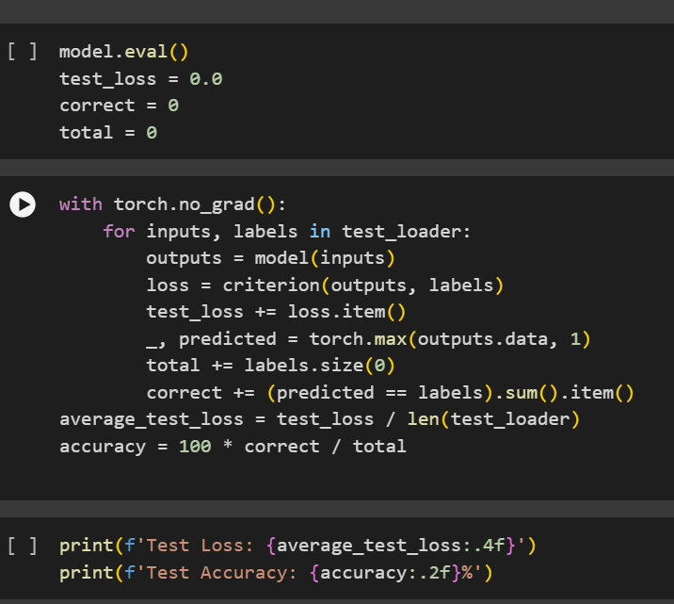
Evaluation

Slide 13
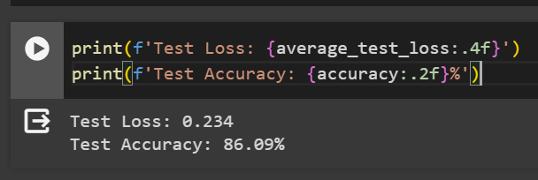
RESULTS

Slide 14
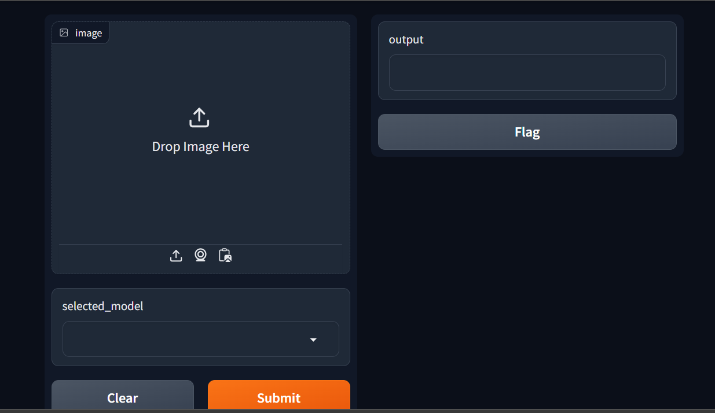
Interface

Slide 15

THANK YOU

